Slide 1
Lab5: Event Group& Mail Box
2023.12.14

Slide 2
Queue:
#include “queue.h”
QueueHandle_t xQueueCreate
( UBaseType_t uxQueueLength, UBaseType_t uxItemSize );
BaseType_t xQueueOverwrite ( QueueHandle_t xQueue,
const void * pvItemToQueue );
//maximum number of items
//each item size, in bytes
//queue handle
//a pointer to the item

Slide 3
BaseType_t xQueuePeek
( QueueHandle_t xQueue,
void * const pvBuffer,
TickType_t xTicksToWait );
BaseType_t xQueueReset
( QueueHandle_t xQueue );

Slide 4
EventGroup:
#include “event_groups.h”
EventGroupHandle_t xEventGroupCreate( void );
EventBits_t xEventGroupSetBits
( EventGroupHandle_t xEventGroup, const EventBits_t uxBitsToSet );

Slide 5
EventBits_t xEventGroupClearBits
( EventGroupHandle_t xEventGroup,
const EventBits_t uxBitsToClear );
EventBits_t xEventGroupWaitBits
( const EventGroupHandle_t xEventGroup,
const EventBits_t uxBitsToWaitFor, const BaseType_t xClearOnExit, const BaseType_t xWaitForAllBits, TickType_t xTicksToWait );

Slide 6
EventBits_t xEventGroupSync
( EventGroupHandle_t xEventGroup, const EventBits_t uxBitsToSet, const EventBits_t uxBitsToWaitFor, TickType_t xTicksToWait )

Slide 7




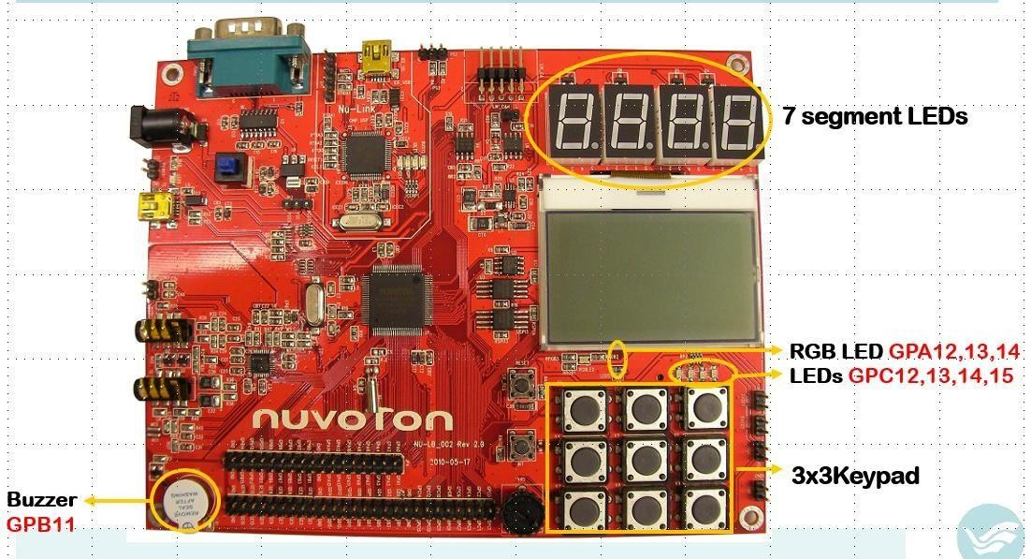
Homework
Type Command
Task C
Send Command
Task
A
Group event
Execute Command
Read Command
Task B
Basic
3 tasks :
Task A :得到由鍵盤輸入的command → set bit
Task B :wait bit並執行
Task C :wait bit並執行
Command : (錯誤command請警示)
•• Taskuse ev
AentBC grouuse e
pventto gr
up to sync
hronize
command | mode1 | mode2 º | mode3 | mode4
Task B(LED) | 由左至 右閃爍 | 由右至 左閃爍 | 恆亮 | 同時閃爍
Task C(RGB LED) | 亮紅光 | 亮綠光 | 亮藍光 | 亮白光

Slide 8
Demo Time
Place : 創新大樓515 助教 林聖培 (門口有貼座位)
Time :
Tuesday 16:00~ 17:30
Thursday 14:30~ 15:30
Report deadline : 12/29(五) PM 11:59
Demo 必須在 Report deadline 前完成
Demo 前需先上傳程式碼
程式碼上傳格式: LABX_ID_NAME.zip
→ main.c + LABX_ID_NAME.docx

Slide 9
Graded
Basic functions 70% + 15%
//Bonus 15%
Report & Code 15%

